Slide 1

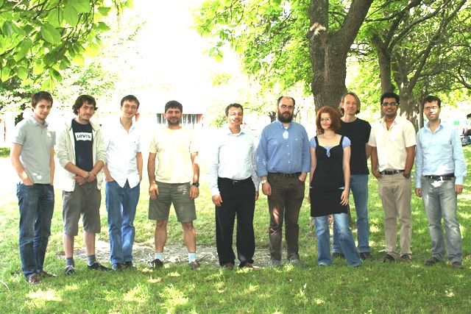




Some experiment with of a chromium dipolar condensate
de Paz (PhD), B. Naylor (PhD), A. Chotia, A. Sharma, O. Gorceix, E. Maréchal, L. Vernac, P. Pedri, B. Laburthe-Tolra
Have left: A. Chotia, A. Sharma, B. Pasquiou , G. Bismut, M. Efremov, Q. Beaufils, J. C. Keller, T. Zanon, R. Barbé, A. Pouderous, R. Chicireanu
Collaborators: Anne Crubellier, Luis Santos, Mariusz Gajda, Johnny Huckans,
Perola Milman Rejish Nath
Notes:
1
1
1
1

Slide 2
During this presentation : two recent experiments
Quantum magnetism with Chromium atoms :
Non equilibrium spin dynamics for DIPOLAR bosons that are loaded in a 3D lattice
Two chromium clouds loaded in a double well trap, interaction via Dipole Dipole interaction:
A classical result.

Slide 3
Chromium : a dipolar BEC due to its large dipole (S=3)
Dipole-dipole interactions
Long range
Anisotropic
R
Van-der-Waals (contact) interactions
short range and isotropic
Relative strength of dipole-dipole and Van-der-Waals interactions
Chromium (S=3)
Cr:
(only few experiments worldwide with non-negligible dipolar interactions
Others dipolar species : Er, Dy, Stuttgart, Innsbruck, Stanford, Boulder

Slide 4
Non equilibirum spin dynamics : sample preparation
-We load a BEC in a deep 3D rectangular lattice, S= 3, m=-3
- The loading is adiabatic and we reach a Mott state, with the “wedding cake” distribution:
2 atoms par site at the center= Doublons
a shell with 1 atom per site = singlons
The different Zeeman populations are measured by a Stern Gerlach
separation

Slide 5
Non equilibrium spin dynamics : sample preparation
-Then we can remove the doublons : simple initial situation, with only intersite interactions
- Atoms, initially in m=-3 are prepared in -2 and the spin dynamic is monitored
Vdd
-2
-2
-3
-1
Heisenberg like hamiltonian
(used in quantum magnetism):
without spin
changing term

Slide 6

Non equilibrium spin dynamics without doublons :
E(m_{s}) = q m_{S}²
comparison with a plaquette model (Pedri, Santos)
3*3 sites , 8 sites containing one atom + 1 hole
quadratic light shift and tunneling taken into account
Evolution due to intersite Dipole Dipole Interations

Slide 7
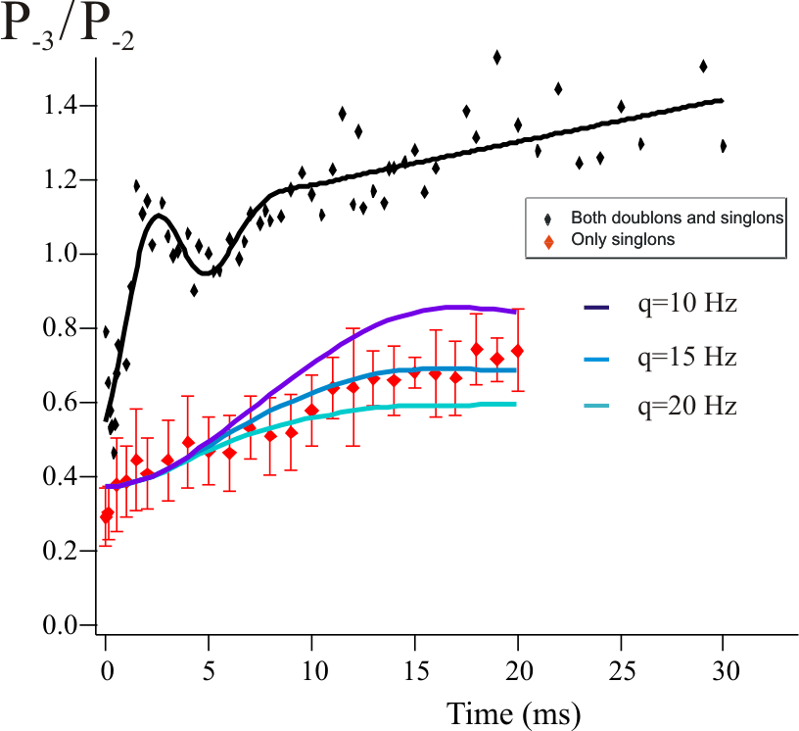
Non equilibrium spin dynamics : is it interesting?
Main originalities of this quantum system :
- True many body system, and anisotropic system
Spin exchange term is due to true magnetic interaction
  independent of tunneling
  the super exchange term is not dominant
  Quantum magnetism with bosons
  Three possible types of exchange :
    Dipole dipole intactions
    Contact Interactions
    Superexchange if more tunneling
U
Super exchange
cartoon :
J
J

Slide 8
A mesoscopic system : two giants dipoles in a two well potential
Initial motivations: direct observation of spin exchange with giant spins,
« two body physics » , no contact interaction, simpler system with intersite interactions
R
N atoms
N atoms
-3
-3
+3
+3
R = 4 µm
N = 5000
Precession of one atom in the field create
by Natoms
Compensate 1/R^3 decrease by N increase
Hz
R = 4 µm
j = 3
N = 5000
Hz

Slide 9
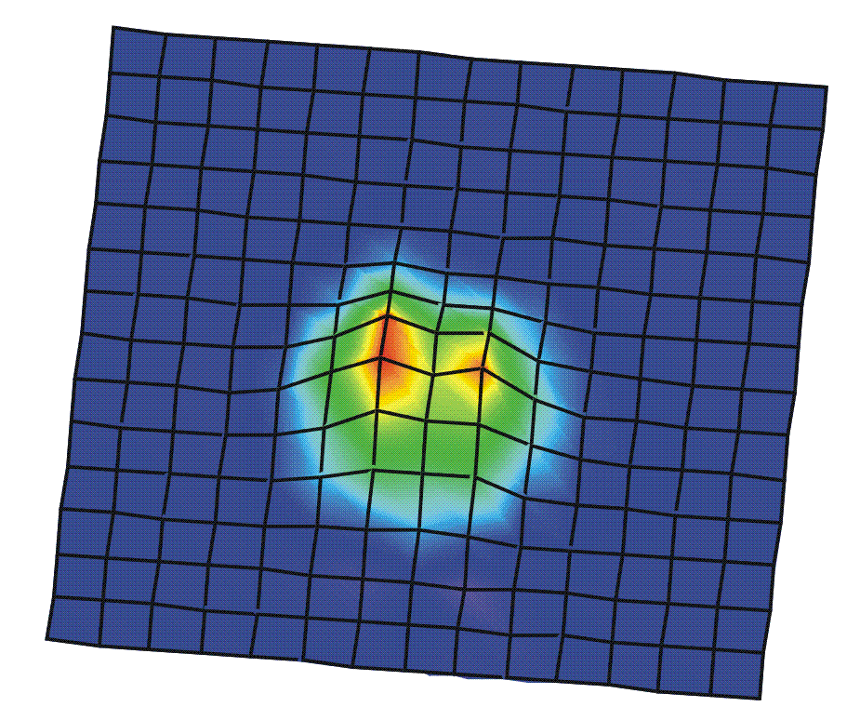
Two giant dipoles in a two well potential : experimental details
Two giant spins of ~10⁴ µ_{B}
Purely dipolar physics
(seems a simpler system :
contact interactions is factorize out)
Long-period lattice
Beams separated in a thermally-stable prism
→ Phase stability
4.1 µm
The spin is selectively flipped for the left atoms in presence of a magnetic field gradient
In situ images

Slide 10
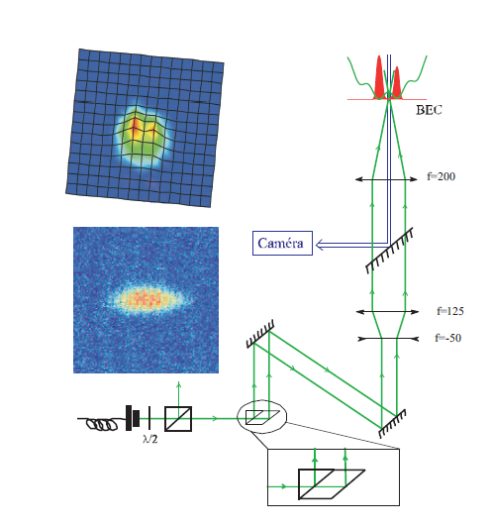
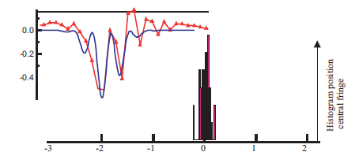
Spin exchange dynamics in a double well trap: realization
realizing a double well
Long-period lattice Beams separated in a thermally-stable Non polarizing Lateral Beam splitter
→ Phase stability

Slide 11
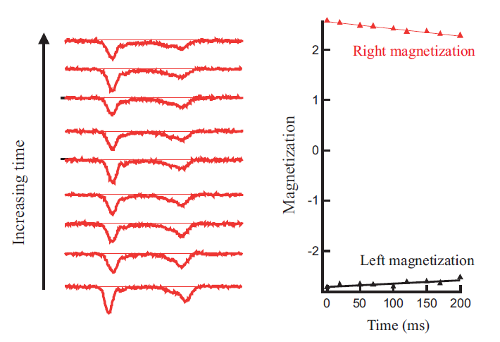
Spin exchange dynamics in a double well trap: first result
But : almost no spin dynamics even
if (Vdd =20 Hz)
The magnetization is frozen.

Slide 12
Larger and larger spin: from quantum to classical magnetism.
Observation of frozen spin dynamics
S=1/2
-2
-2
-3
-1
Right
S=3
Less and less quantum-ness
Magnetization per atom
S=10⁴
Left
2S+1 states
Ising contribution
gives different
diagonal terms
Time (ms)
Ising term
Exchange term
Interpretation: spin-exchange dynamics frozen by Ising term
Beware of large spins !

Slide 13
Spin exchange dynamics in a double well trap: result
-The slow evolution is due to contact interaction between the two clouds that are not
fully separated
We could measure a₀ , the unknown scattering length in S=0 molecular channel
for chromium. a₀ is negative, and our measurements give a₀=-100 a _{Bohr}

Slide 14
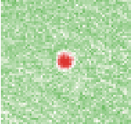
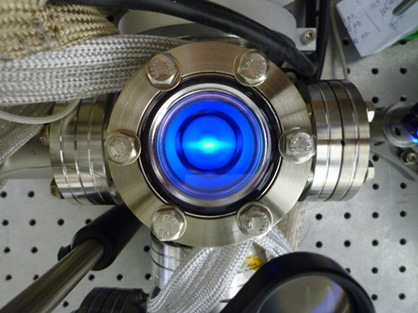
Other results and futur work
- Recent production of a Fermi see of ⁵³Cr
1000 atoms, T/TF= 0,6 (slightly degenerate)
Fermionic magnetism very different…
- New experiment with strontium quantum gases
New lab, laser system, oven
Quantum magnetism using fermionic Sr in lattices
Thank you!

Slide 15
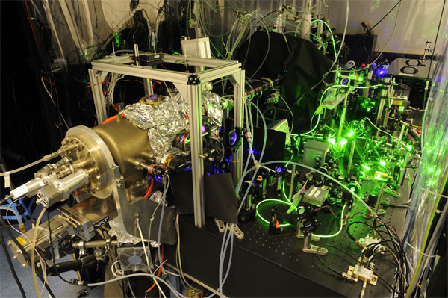
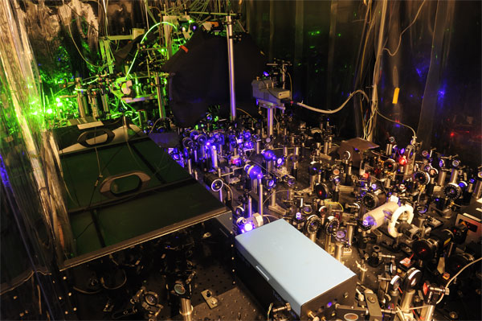
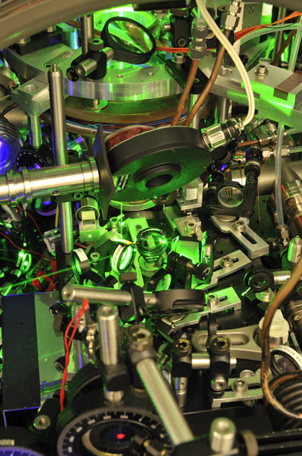
Notes:
15

Slide 16
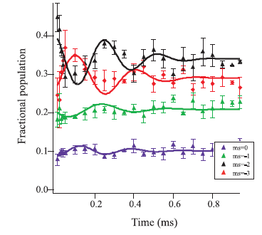
short time scale :
Spin exchange dynamics in a 3D lattice with doublons (Contact interactions)
-3
-2
-2
-1
On site contact
interactions
- |S=3,m=2>+|S=3,m=2> ⬄ α|6,6>_{Mol} +β |6,4>_{Mol} -> a₆ and a₄ (60 nm )
Γ=
(↔ 320 µs)

Slide 17
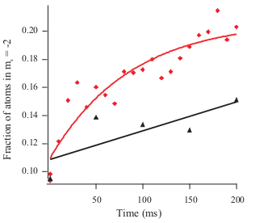
Contact Spin exchange dynamics from a double well trap after merging
after merging
without merging
Spin exchange dynamics due to contact interactions
Fit of the data with theory gives an estimate of a₀ the unknown scattering length of chromium

Slide 18
Production of a degenerate quantum gas of fermionic chromium
So many lasers…
⁷P₄
⁵³Cr MOT :
Trapping beams sketch
⁵³Cr MOT :
laser frequencies production
⁷S₃
Lock of Ti:Sa 2 is
done with an ultrastable cavity

Slide 19
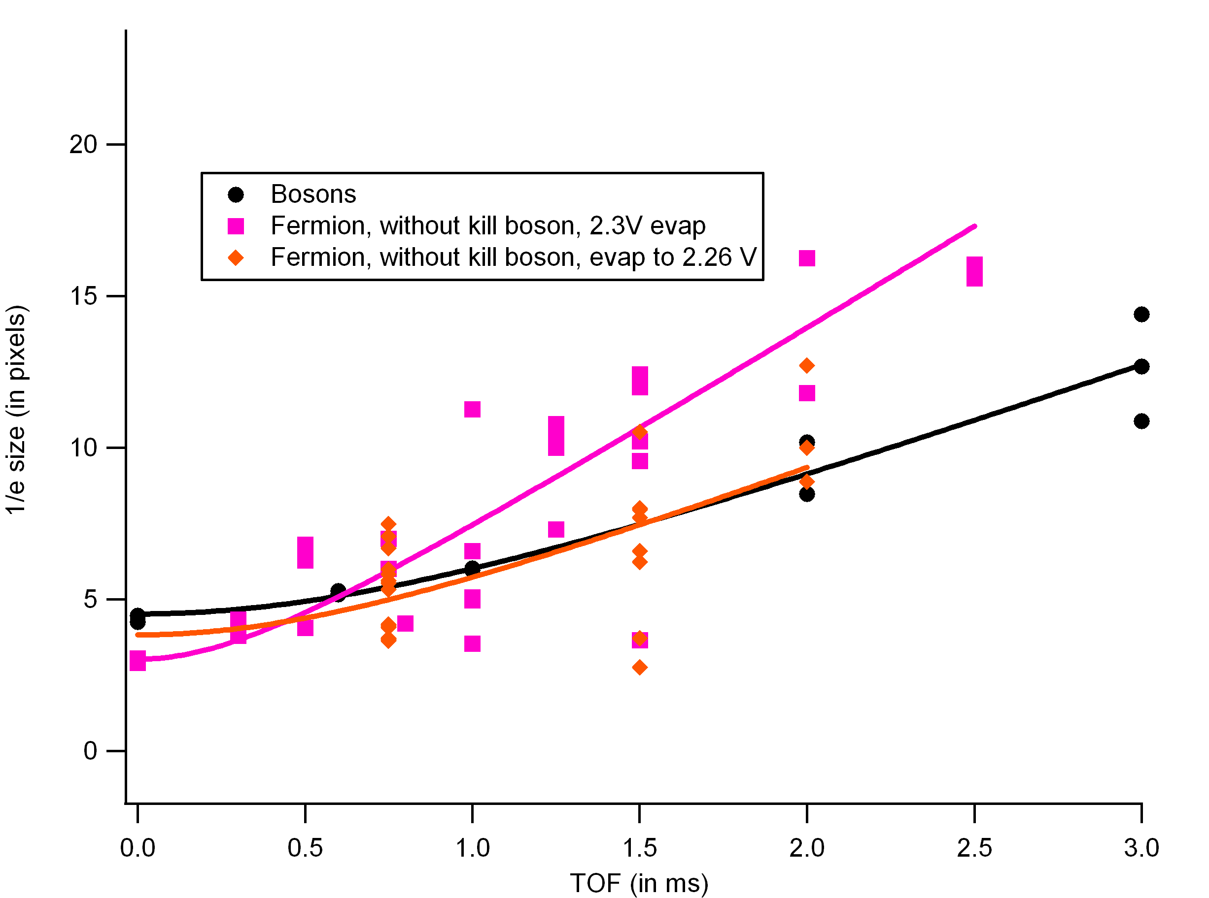
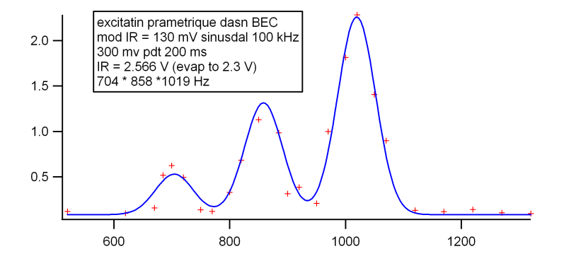
Production of a degenerate quantum gas of fermionic chromium
Results
In situ images
Expansion analysis
N_{at}
parametric excitation of the trap
trap
frequencies
Temperature
slightly degenerated

Slide 20
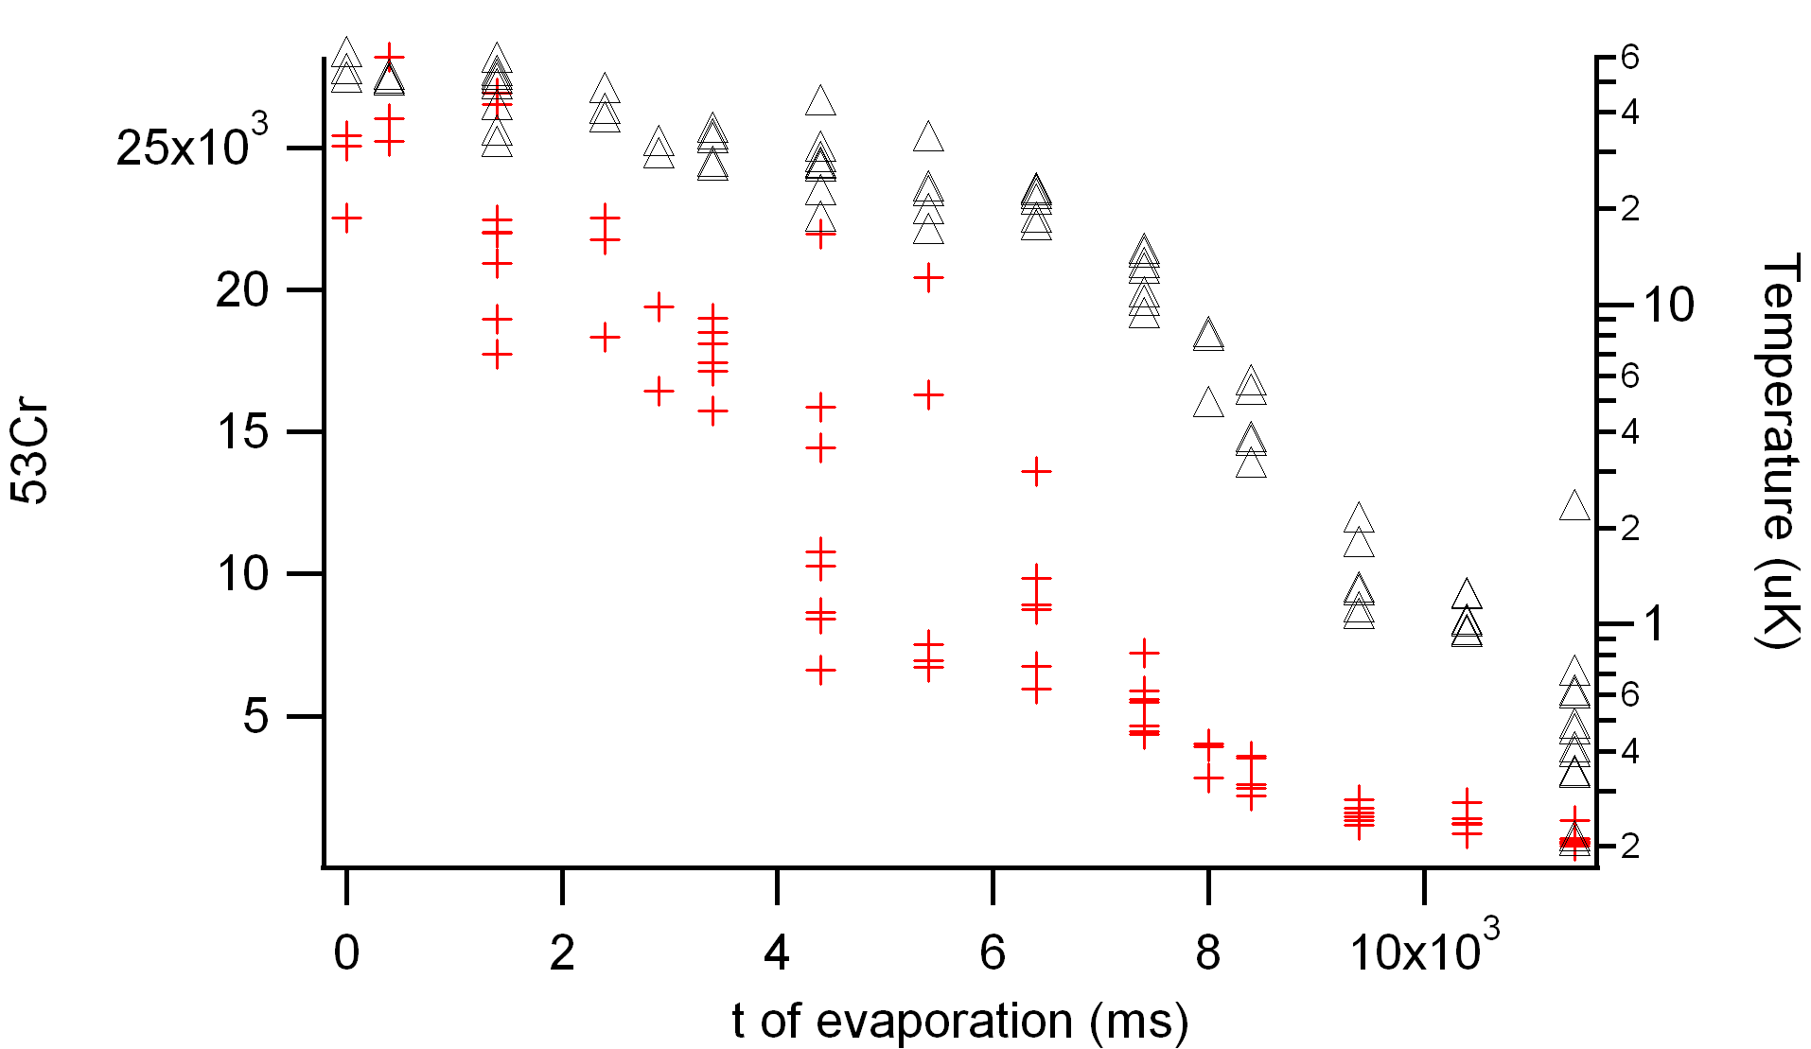
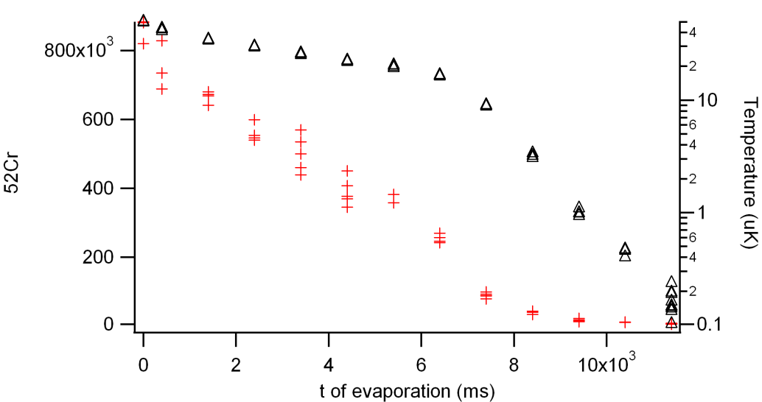
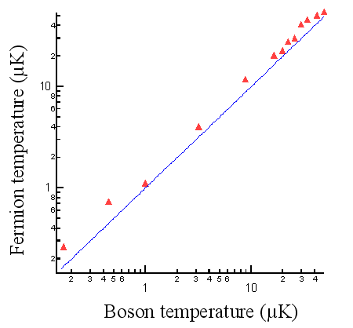
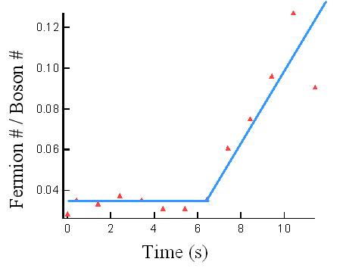
Production of a degenerate quantum gas of fermionic chromium
Evaporation

Slide 21
Production of a degenerate quantum gas of fermionic chromium
What can we study with our gas?
Fermionic magnetism
9/2
7/2
3
5/2
Phase separation
very different from bosonic magnetism !
3/2
2
1/2
Picture at T= 0 and no interactions
1
-1/2
0
-3/2
-1
-5/2
-2
-7/2
-3
-9/2
Boltzmann
requires good in situ imaging
Population
in m_{F}=-9/2
T=10 nK
T=50 nK
Fermi T=0
T=200 nK
minimize E_{tot}
Larmor
frequency
(kHz)

